Slide 1

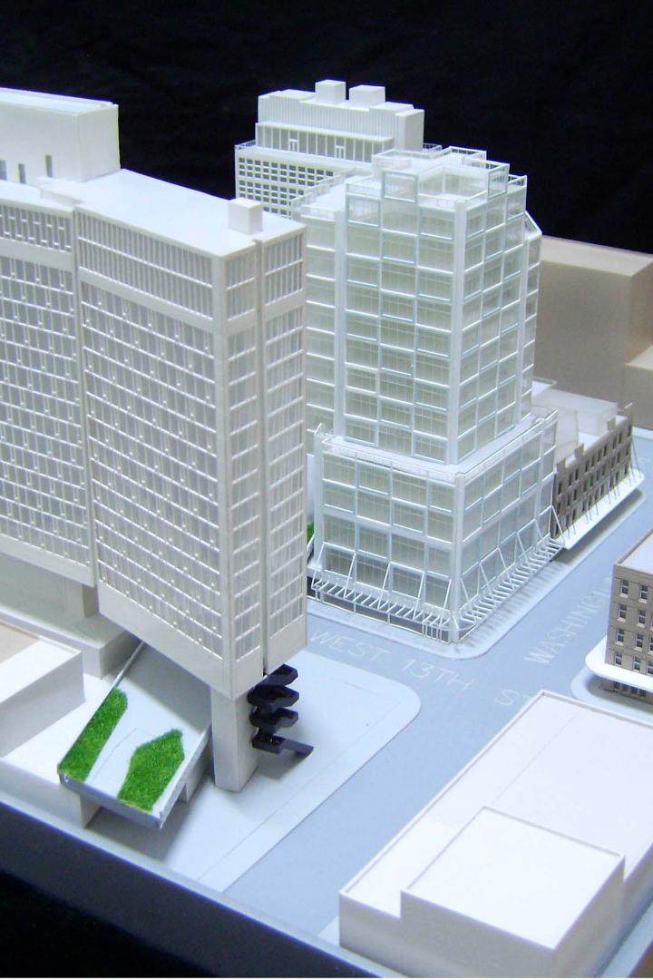
Revolutionizing 3D Modeling
We are introducing a next-generation 3D modeling tool that surpasses the challenges of current software. It focuses on user-friendly interfaces, enhanced collaboration features, and adaptability to different design disciplines.
TEAM MEMBERS:
ASHISH RUKE
SHRUTI NIMBARKAR
HARSHVARDHAN JAGDALE
SANDESH

Slide 2
CONTENT
PROBLEM STATEMENT
01
02
MOTIVATION
INTRODUCTION
03
O4
PROPOSED WORK
RESULTS
05
06
CONCLUSION
FUTURE WORK
07
08
RESEARCH PAPERS

Slide 3


Introduction to 3D Modeling
3D modeling is a transformative digital art form that brings imagination to life by creating three-dimensional representations of objects, scenes, or characters. Unlike traditional 2D art, 3D modeling adds depth and realism to visual creations, making it an essential tool in various industries, including animation, gaming, virtual reality, architecture, and product design.
At its core, 3D modeling is the process of developing a mathematical representation of any three-dimensional surface or object using specialized computer software. This digital model can be manipulated and viewed from different angles, providing a versatile canvas for creative expression and practical application.

Slide 4
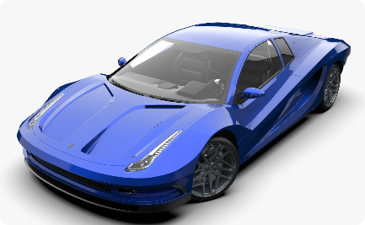
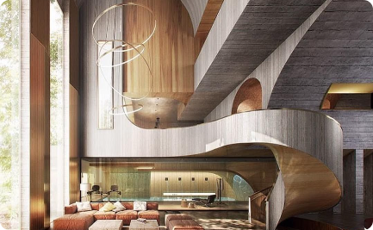
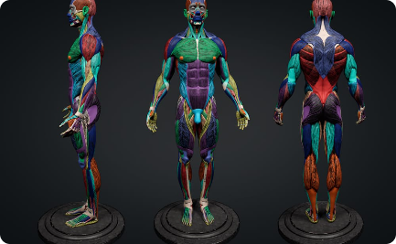
Applications of 3D Modeling
Manufacturing
Architecture
Medicine
3D modeling is used to create precise designs that can be tested and improved before production.
Architects use 3D models to visualize and simulate a building's structure, interiors, and exteriors.
3D modeling technology helps doctors plan surgeries and diagnosis by creating accurate 3D models of patients' anatomy and organs.

Slide 5
Process of Creating a 3D Model
1
Concept
Start with an idea or a design brief, and sketch some rough concepts before proceeding to 3D modeling.
Modeling
2
Use 3D modeling software to create the basic structure of the object and add details, textures, and colors.
3
Refinement
Refine the model by removing imperfections, optimizing details, and adding finishing touches.
Delivery
4
Export and share the final 3D model with others, or use it for manufacturing, prototyping, or visualization.

Slide 6

Types of 3D Modeling Software
1
Parametric Modeling
This type of modeling is based on parameters that define the object's shape, size, and dimensions. Examples include SolidWorks, Autodesk Inventor, and CATIA.
2
Sculpting
Sculpting software offers artists the freedom to create complex organic shapes using tools similar to traditional sculpting techniques. Examples include ZBrush, Sculptris, and Mudbox.
3
Rendering
Rendering software focuses on creating photorealistic, high-quality images and videos of 3D models. Examples include V-Ray, Blender, and KeyShot.

Slide 7
Requirements:
Python 3
PyTorch tested on 1.4.0
PIL
skimage
numpy
cv2

Slide 8
Common Challenges in 3D Modeling
Computational complexity
Accuracy and precision
Models with high polygon counts can significantly slow down software and make the modeling process frustrating.
Even the slightest imperfection or inconsistency can ruin the entire model, so the artist has to pay attention to even the smallest details.
Learning curve
Collaboration
3D modeling software can be overwhelming and complex, so beginners may struggle to get started.
Working with others on a 3D model can be challenging, especially if each team member has a different set of skills and software preferences.

Slide 9
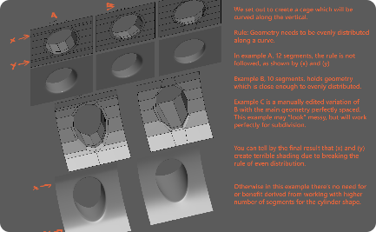
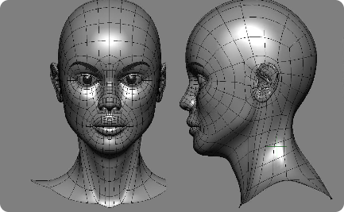
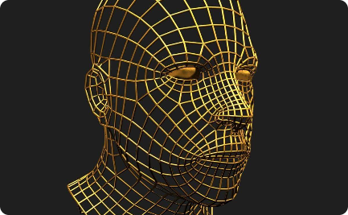
Tips for Improving 3D Modeling Skills
Online Tutorials
Reference Images
Wireframes
There are a plethora of free video tutorials available online that can help you improve your 3D modeling skills and learn new ones.
Reference images are essential for creating realistic 3D models. Use different angles and perspectives to achieve the desired level of accuracy.
Creating a wireframe of your model can help you see the bigger picture and identify potential flaws or inconsistencies.

Slide 10
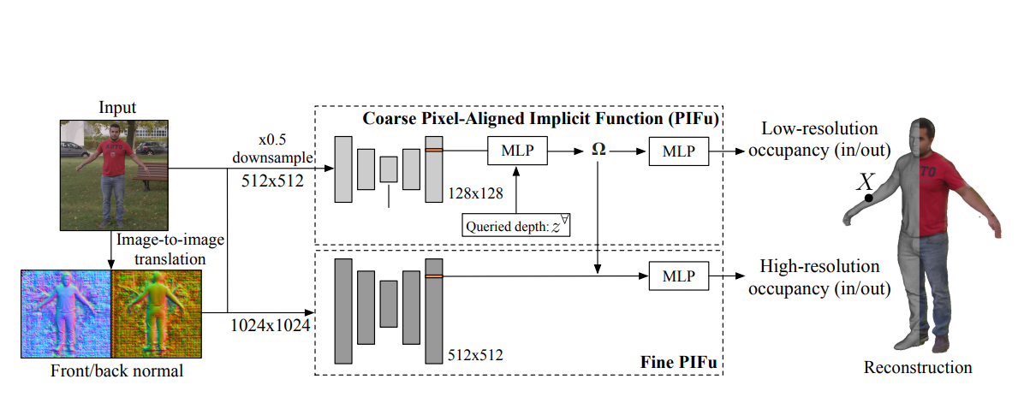
FRAMEWORK:

Slide 11
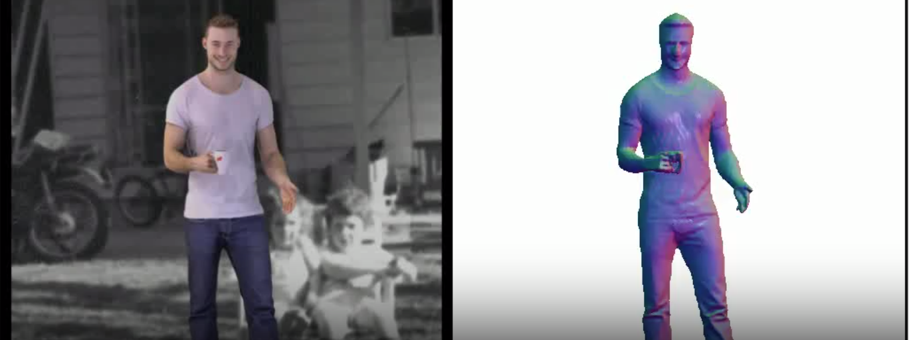
Result:

Slide 12

RESEARCH PAPERS
1. "Meta-SURFNet: A Neural Architecture for Robust 3D Shape Classification"
Authors: Xiaojie Guo, Lingjing Wang, Yizhou Yu.
Published in: CVPR, 2021.
2. "ShapeNet: An Information-Rich 3D Model Repository"
Authors: Angel X. Chang, Thomas Funkhouser, Leonidas J. Guibas, et al.
Published in: arXiv, 2015.
3. "MeshCNN: A Network with an Edge"
Authors: Rana Hanocka, Amir Hertz, Noa Fish, et al.
Published in: SIGGRAPH Asia 2019.
4. "DeepVoxNet: Learning Shape Reconstruction from 3D and 2D Data"
Authors: Alexey Gruzdev, Matthias Nießner.
Published in: ECCV (European Conference on Computer Vision), 2020.
5. "PIFuHD: Multi-Level Pixel-Aligned Implicit Function for High-Resolution 3D Human Digitization"
Authors: Shunsuke Saito, Zeng Huang, Ryota Natsume, et al.
Published in: CVPR, 2020.

Slide 13
CONCLUSION:
We present a multi-level framework that performs joint reasoning over holistic information and local details to arrive at high-resolution 3D reconstructions of clothed humans from a single image without any additional post processing or side information. Our multi-level Pixel-Aligned Implicit Function achieves this by incrementally propagating global context through a scale pyramid as an implicit 3D embedding

